Slide 1


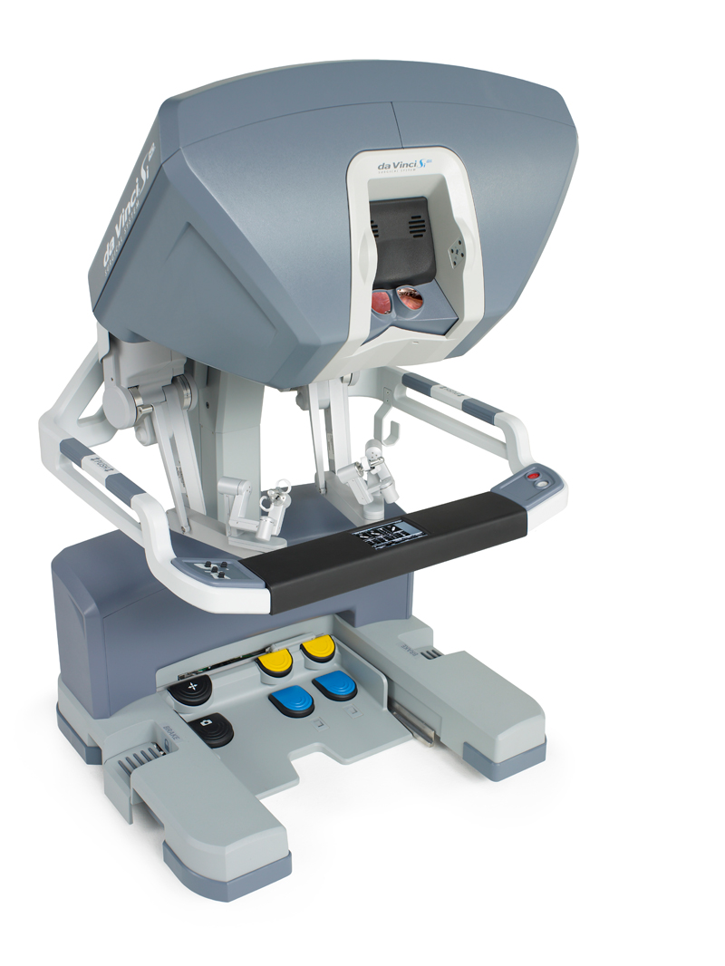
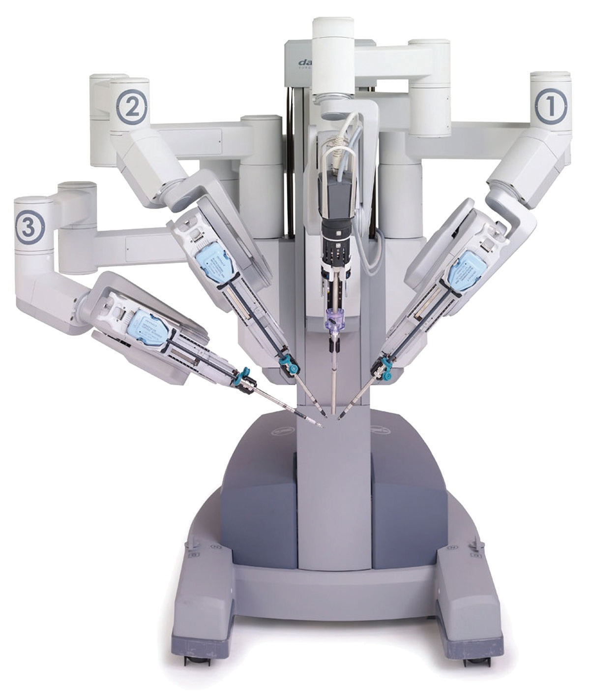
Evaluation of Video Game Skill for Future Training Modalities in Robotic-Assisted Surgery.
Oh, Kenny J.*, Esposito, Andrew*, Owen-Simon, Nina, Dachert, Stephen, Kaplan, J., Kamenko, A., Shipman, S., Rehrig, J., Walters, K., Ray, K., Nadhan, K., Wood, M., Musser, L., Buchanan, E., Kim, A., Kim, E., Kim, J., Suh, A., Shiau, G., Reese, A., Harbin, A., Waldorf, B. and Eun, D. Department of Urology, Lewis Katz School of Medicine at Temple University, Philadelphia, PA 19140
INTRODUCTION
RESULTS
CONCLUSION
Robotic Assisted Surgery (RAS) has grown in popularity in the recent decade as an alternative to laparoscopic and open surgeries. Its use continues to be pioneered in multiple surgical subspecialties.
Traditionally, selection of surgical trainees has been based on cognitive factors (academics), personality, attitude, and motivation but has not included innate dexterity. However, innate dexterity was identified by directors of surgical training programs as an important factor in determining ultimate technical proficiency of a surgeon.
Previous research has investigated positive correlation between RAS ability and past video game experience.
This is the first prospective study to examine the connection between video game skill and RAS skill.
Preliminary results from 26 subjects are described. The distribution of video game final scores ranged from 681.42 to 11016.43 with a mean of 4553.38 (SD=2885.7). On Da Vinci, timed tasks included peg transfer (mean= 2:10.7 min, SD = 40.6 sec), precision cutting (mean= 3:20.56 min, SD = 73.2 sec), and running suture (mean= 5:51.9 min, SD = 60.0 sec). Correlations were calculated across trials controlling for random intercepts by participant and are graphically represented here.
A significant inverse relationship existed between final video game score and running suture time, r =-.33, p < 0.01.
Relationships approaching significance occurred in the remaining timed tasks, precision cutting and peg transfer, with trends approaching significance at r = -.23, p = 0.08 and r = -.23, p = 0.085.
Video game skill and RAS skill have a significant correlation.
This study is the largest prospective study to date investigating skills predicting RAS performance.
As use of RAS is increasingly prominent, it is essential to identify skill sets predictive of proficiency on this platform to develop future surgical teaching strategies and education curricula.
REFERENCES
Abboudi, H., Khan, M., Aboumarzouk, O. et al. Current status of validation for robotic surgery simulators – a systematic review. BJU Int. 2013;111(2):194-205.
Brinkman, W., Luursema, J., Kengen, B. et al. da Vinci Skills Simulator for assessing learning curve and criterion-based training of robotic basic skills. Urology. 2013;81:562-566.
Dulan, G., Rege, R., Hogg, D. et al. Developing a comprehensive, proficiency-based training program for robotic surgery. Surgery. 2012;152(3):477-488.
Harper, J., Kaiser, S., Ebrahimi, K. et al. Prior video game exposure does not enhance robotic surgical performance. J Endourol. 2007;21:1207-1210.
Lynch, J. Aughwane, P, Hammond T. Video games and surgical ability: a literature review. J Surg Educ. 2010;67:186-189.
Moglia, A., Ferrari, V., Morelli, L. et al. Distribution of innate ability for surgery amongst medical students assessed by an advanced virtual reality surgical simulator. Surg Endosc. 2014;28(6): 1830- 1837.
Rosser, J., Lynch, P., Cuddihy, L. et al. The impact of video games on training surgeons in the 21st century. Arch Surg. 2007;142:181-186.
METHODS
116 undergraduate and pre-clinical medical students took a diagnostic exam on the Nintendo Wii system, completing three attempts of five levels of “Super Monkey Ball: Banana Blitz”. Composite scores were calculated based on task completion and time to completion.
Subjects then performed 5 attempts each of peg transfer, pattern cutting, and running suture on the Da Vinci Xi Surgical Robot (Da Vinci). Time to completion and accuracy of tasks were recorded.
Participants with prior experience in either video game or Da Vinci were excluded.
Figure 1: Correlation of Video Game Score and Running Suture Time
Figure 2: Correlation of Video Game Score and Precision Cutting Time and Peg Transfer Time and Video Game Score and Peg Transfer

